Slide 1
CSE115
Lecture 7
Dr. Mohammad Abu Yousuf (MAY)

Slide 2
Control Statement

Slide 3
Branching
THE if STATEMENT
Syntax:
if ( expression) statement
The expression must be placed in parentheses, as shown. In this form, the statement will be executed only if the expression has a nonzero value (i.e., if expression is true). If the expression has a value of zero (i.e., if expression is false), then the statement will be ignored.
The statement can be either simple or compound.
Example : 1) if( x < 0)
printf ( "%f' I , x ) ;
2) if (x <= 3.0) {
y = 3 * pow(x, 2 ) ;
printf ( "%f\n", y) ;
}

Slide 4
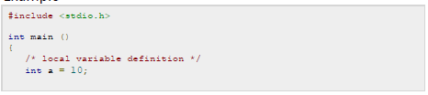
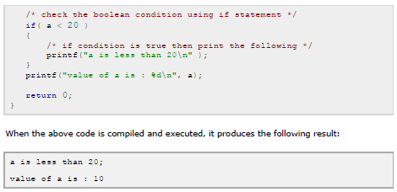
Branching
If statement example:

Slide 5
Branching
THE if - else STATEMENT
Syntax:
if (expression) statement 1 else statement 2
If the expression has a nonzero value (i.e., if expression is true), then statement1 will be executed. Otherwise (i.e., if expression is false), statement2 will be executed.
Example: if (x <= 3)
y = 3 * pow(x, 2 ) ;
else
y = 2 * pow(x - 3 ) , 2 ) ;

Slide 6
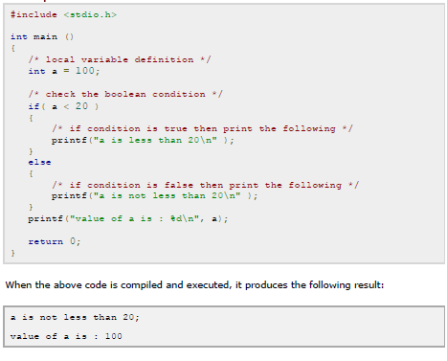
Branching
If-else statement example

Slide 7
Branching
THE if - else if – else STATEMENT
Syntax:
if (expression1)
statement 1
else if (expression2)
statement 2
else if (expression3)
statement 3
else
statement 4

Slide 8
Branching
if - else if – else Example:
#include <stdio.h>
int main ()
{
int x,y;
printf ("\nInput an integer value for x: ");
scanf ("%d", &x);
printf ("\nInput an integer value for y: ");
scanf ("%d",&y);
if (x==y)
printf ("x is equal to y\n");
else if (x > y)
printf ("x is greater than y\n");
else
printf ("x is smaller than y\n");
return 0;
}

Slide 9
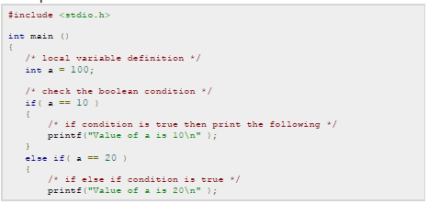
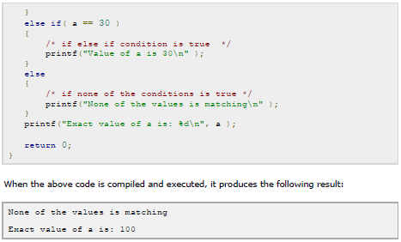

Slide 10
Branching
Nested if statement-
Syntax:
if e1 {
if e2 s1
}
else s2

Slide 11
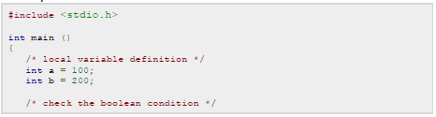
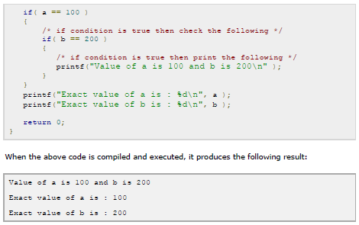
Branching
Nested If statement example:

Slide 12
LOOPING : THE while STATEMENT
THE while STATEMENT
The while statement is used to carry out looping operations, in which a group of statements is executed repeatedly, until some condition has been satisfied.
Syntax:
while ( expression) statement
The statement will be executed repeatedly, as long as the expression is true (i.e., as long expression has a nonzero value). This statement can be simple or compound, though it is usually a compound statement.

Slide 13
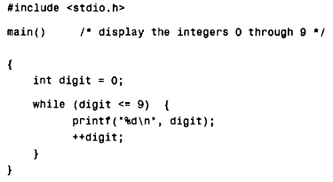
LOOPING : THE while STATEMENT
While statement example1:
Suppose we want to display the consecutive digits 0, 1, 2, . . . ,9, with one digit on each line. This can be accomplished with the following program.

Slide 14
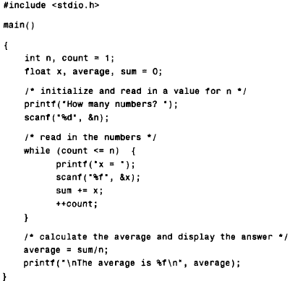
LOOPING : THE while STATEMENT
While statement example 2 : Averaging list of numbers

Slide 15
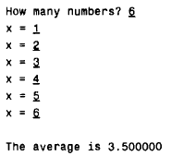
LOOPING : THE while STATEMENT
While statement example2 :
Output of previous slide program

Slide 16
LOOPING : THE do-while STATEMENT
Syntax:
do statement while (expression);
The statement will be executed repeatedly, as long as the value of expression is true (i.e., is nonzero).
Notice that statement will always be executed at least once, since the test for repetition does not occur until the end of the first pass through the loop.
What is the difference between while and do-while ?

Slide 17
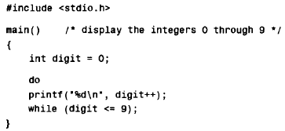
LOOPING : THE do-while STATEMENT
Consecutive Integer Quantities

Slide 18
LOOPING: THE for STATEMENT
Syntax:
for ( expression 1; expression 2; expression 3) statement
where expression 1 is used to initialize some parameter (called an index) that controls the looping action.
Expression 2 represents a condition that must be true for the loop to continue execution.
Expression3 is used to alter the value of the parameter initially assigned by expression 1. Typically, expression 1 is an assignment expression, expression 2 is a logical expression and expression 3 is a unary expression or an assignment expression.

Slide 19
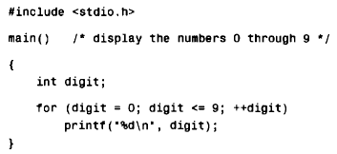
LOOPING: THE for STATEMENT
Consecutive Integer Quantities

Slide 20
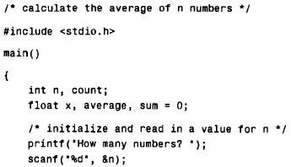
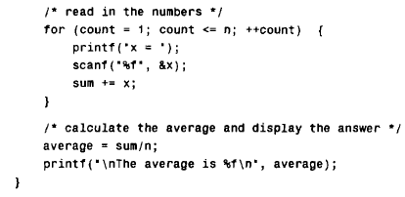
LOOPING: THE for STATEMENT
Averaging a list of numbers

